Slide 1
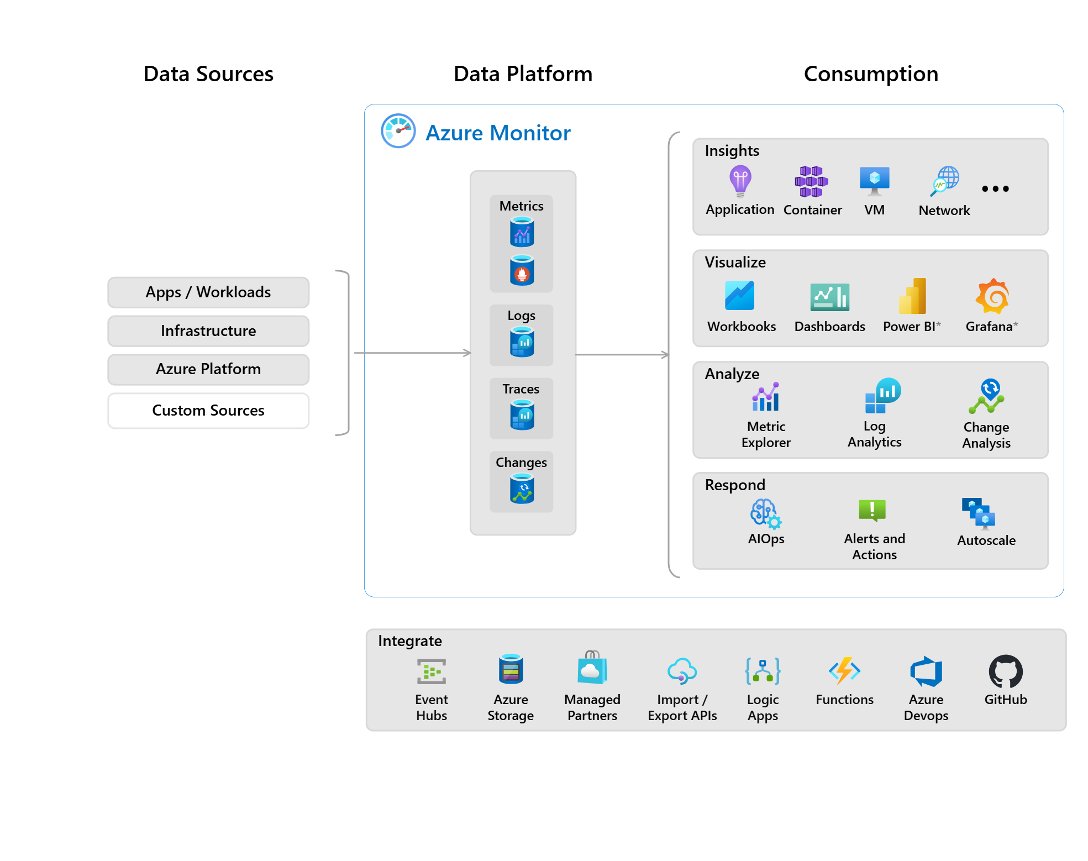
AI-Powered USAGM Azure Data Platform
Explore the seamless integration of AI throughout the software development lifecycle, enabling rapid delivery of enterprise data solutions.

Slide 2
Executive Overview
Knowledge Transfer
AI-assisted development training programs, Best practices documentation, Continuous learning and improvement cycles
Exponential Development Velocity
AI-assisted coding and automation deliver enterprise-grade solutions in dramatically reduced timeframes
Zero Technical Debt
AI-generated documentation and best practices maintain high quality and comprehensive documentation
Future-Ready Architecture
Scalable, maintainable, and self-documenting data platform
Organizational Learning
Establishing AI-first development culture

Slide 3
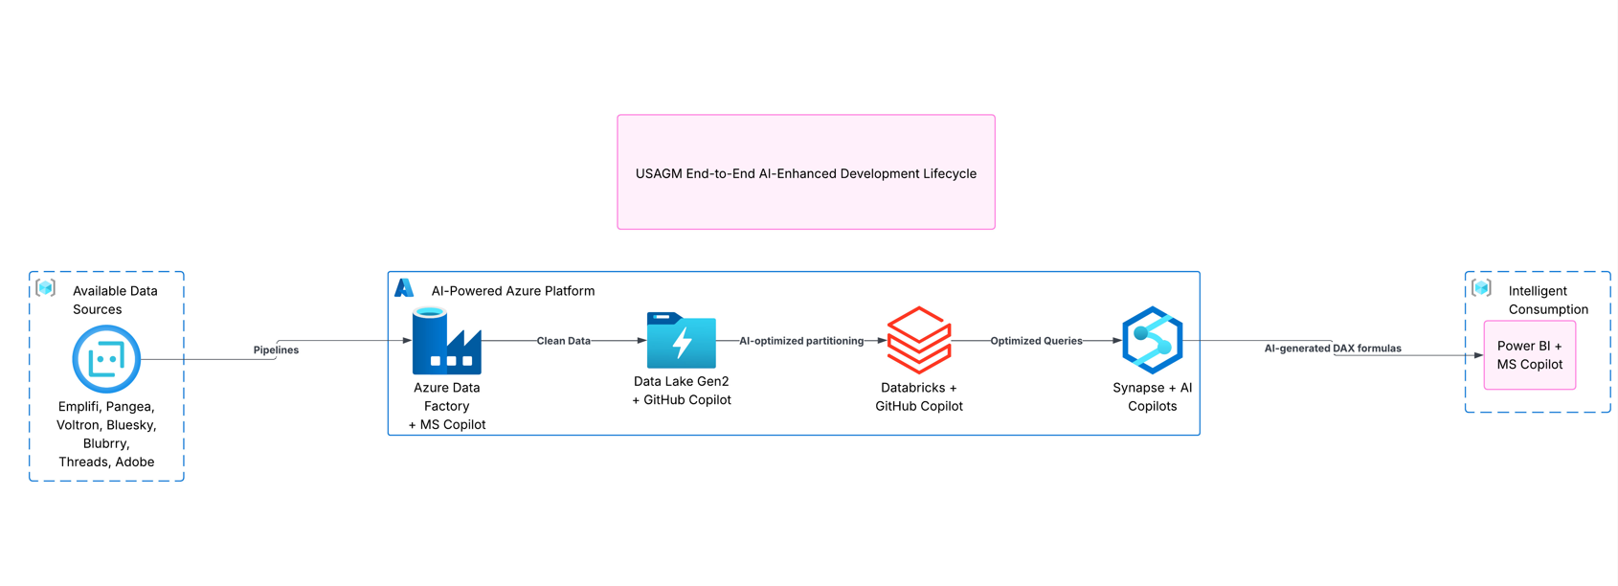
AI-Powered Azure Data Platform Architecture

Slide 4




AI-Powered SDLC Architecture
AI Integration Across Development Stages
Medallion Architecture with AI Optimization
AI-Powered Azure Services
Development Acceleration Metrics
The architecture integrates AI capabilities across the entire software development lifecycle, including data processing, pipeline orchestration, database development, CI/CD automation, and more.
The data platform follows a Medallion architecture (Bronze, Silver, Gold layers) with AI-powered optimizations for data ingestion, curation, and transformation.
The solution leverages various Azure services like Data Factory, Data Lake, Databricks, and Synapse Analytics, all enhanced with AI-powered capabilities.
The implementation demonstrates significant time savings across different development components when compared to traditional methods.

Slide 5




AI-Enhanced Development Workflow
Exponential Development Velocity
Future-Ready Architecture
Scalable, maintainable, and self-documenting
AI-assisted coding and automation
Zero Technical Debt
Organizational Learning
AI-generated documentation and best practices
Establishing AI-first development culture

Slide 6
Medallion Architecture with AI Optimization
Bronze Layer (AI-Ingested Raw Data)
Silver Layer (AI-Curated Clean Data)
Gold Layer (AI-Optimized Business Data)
GitHub Copilot generates API connection logic, automated retry mechanisms, and error handling. AI-optimized file format selection and partitioning.
GitHub Copilot writes data validation and cleansing logic, handles intelligent schema evolution, and deploys AI-powered duplicate detection algorithms.
AI-generated business rule implementations, automated performance optimization suggestions, and intelligent aggregation and indexing strategies.
AI-Powered Azure Services
Development Acceleration Metrics
Azure Data Factory + Microsoft Copilot, Azure Data Lake Gen2 + GitHub Copilot, Azure Databricks + GitHub Copilot, Azure Synapse Analytics + Dual AI Support.
Significant time savings across data processing logic, pipeline creation, database schema design, CI/CD setup, and documentation compared to traditional development.

Slide 7
AI-Powered Azure Services
Time Savings Comparison for Key Development Components
92%
88%
83%
81%
75%
Data Processing Logic
Pipeline Creation
Database Schema Design
CI/CD Setup
Documentation

Slide 8
Implementation Strategy
AI-First Development Approach
Phased approach to leverage AI throughout the software development lifecycle, including AI-powered infrastructure, pipeline development, analytics, and delivery.
Phase 1: AI-Powered Foundation
GitHub Copilot setup and workspace configuration, AI-generated infrastructure-as-code templates, and automated Azure resource provisioning.
Phase 2: Intelligent Pipeline Development
AI-assisted data source analysis and connection logic, GitHub Copilot-generated transformation pipelines, and Microsoft Copilot-created ADF orchestration.
Phase 3: Smart Analytics Layer
AI-powered Synapse schema design, GitHub Copilot-generated stored procedures and views, and automated performance optimization.
Phase 4: AI-Enhanced Delivery
AI-generated CI/CD pipelines, automated testing and deployment, and AI-created documentation and handover materials.

Slide 9


Success Metrics & KPIs
Metric
Target
Measurement Method
Code Generation Speed
Exponentially faster
Lines of code per hour
Bug Reduction
70% fewer issues
Post-deployment defect tracking
Documentation Coverage
100% automated
AI-generated documentation ratio
Development Velocity
85% time reduction
Sprint velocity comparison
*Section 5.1 AI Development Efficiency from the provided context

Slide 10

The USAGM Azure Data Platform project showcases the transformative power of AI-driven development, establishing a blueprint for enterprise-grade solutions that are built faster, better, and more sustainably.

